Slide 1
CSR APP Instruction
Sept 2025

Slide 2
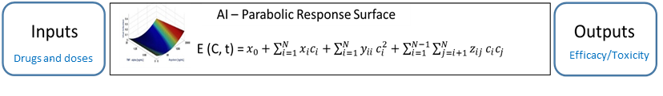
Introduction to CSR
CSR Function
Optimization in multi-parameter space is challenging. The key roadblock is that N parameters with M levels for each parameter form a huge M^{N} search space. If trial-and-error approach is adapted, it is a daunting task to search through the entire M^{N} space for the optimal parameter-level combination.
With an artificial neural networks analysis of a set of test data, the input-output response was found to be a smooth surface. The complex system response (CSR) surface can be represented by the CSR function.
………………Function (1)
C_{i} are the levels, E(C, t) is the output performance. x_{i}, y_{ij}, z_{ij}, are coefficients to be determined by experiments. These coefficients are functions of the independent variables, i.e. time and C_{i}, and hence are not constants. The number of coefficients is [1+N+N+N(N−1)/2 = [(N²+3N+2)/2]. Hence, only small number of calibration tests , [(N²+3N+2)/2], can find the optimal output instead of searching in a large M^{N} space.
No. of Parameters | (N²+3N+2)/2 | M^{N} (M=10)
1 | 3 | 10
2 | 6 | 10²
3 | 10 | 10³
4 | 15 | 10⁴
5 | 21 | 10⁵
6 | 28 | 10⁶
12 | 91 | 10¹²
Table 1: The number of tests

Slide 3
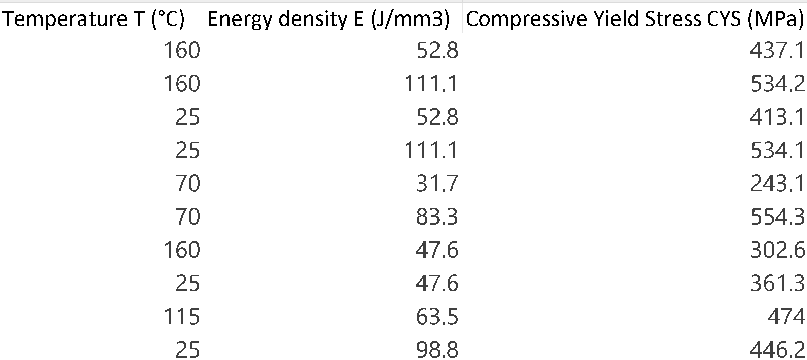
Step 1 -- Load data
Navigate to the CSR Integration tab --> Click on Select Data File --> Choose the .xlsx file containing experimental data
The .xlsx file must follow the following format:
The first row specifies the names of all factors and results
Subsequent rows contain the corresponding data entries.
Example:

Slide 4
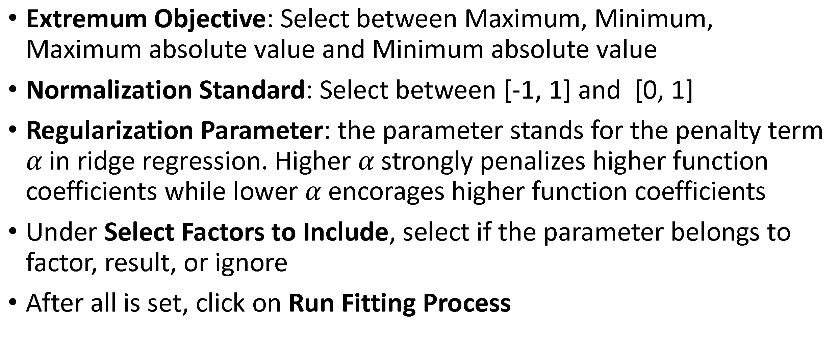
Step 2 -- Configure setting
Extremum Objective: Select between Maximum, Minimum, Maximum absolute value and Minimum absolute value
Normalization Standard: Select between [-1, 1] and [0, 1]
Regularization Parameter: the parameter stands for the penalty term $α$ in ridge regression. Higher $α$ strongly penalizes higher function coefficients while lower $α$ encorages higher function coefficients
Under Select Factors to Include, select if the parameter belongs to factor, result, or ignore
After all is set, click on Run Fitting Process

Slide 5
Step 3 -- Result display
CSR Function displays the numerical expression of the fitted function.
Factor Definitions list the names of the parameters used in the function.
Extremum indicates the maximum/minimum point of the plot. If multiple result columns are selected, then Individual Results at Extremum will be shown below
Model Fit provides the R-square value of the model
Actual vs. Predicted Values presents the deviations between predicted outcomes and observed data.
CSR Response Surface Plot provides a graphical representation of the fitted CSR function.

Slide 6
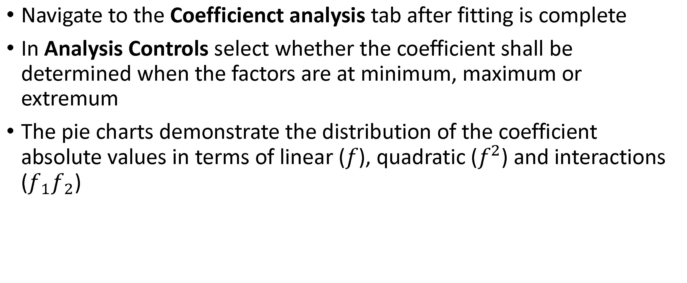
Step 4 -- Coefficeint analysis
Navigate to the Coefficienct analysis tab after fitting is complete
In Analysis Controls select whether the coefficient shall be determined when the factors are at minimum, maximum or extremum
The pie charts demonstrate the distribution of the coefficient absolute values in terms of linear ($f$), quadratic ($f^{2}$) and interactions ($f_{1}f_{2}$)

